Slide 1
Reminders
Health Resource Packet due Friday in Blackboard
Presentations start Feb 17!
What needs some work?

Slide 2
Stress, Overeating, and Your Digestive Tract
Chapter 5

Slide 3
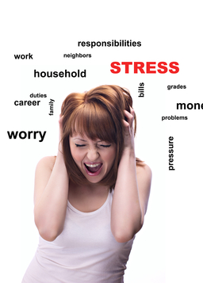
OMG! I’m so stressed!
I get stuck in traffic every day, I have a horrible professor, my relationship is unsteady, all of these sorts of things, and I’m totally stressed nonstop, 24-7!”

Slide 4
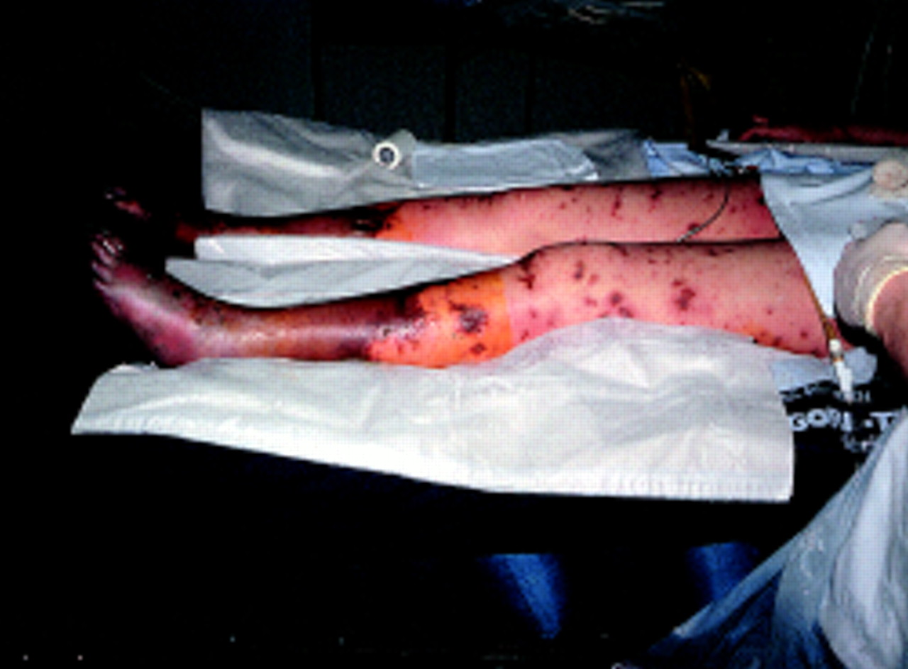
This is stress 24-7!
Septic shock!

Slide 5
What we call everyday chronic stress is instead lots and lots of intermittent stressors.

Slide 6
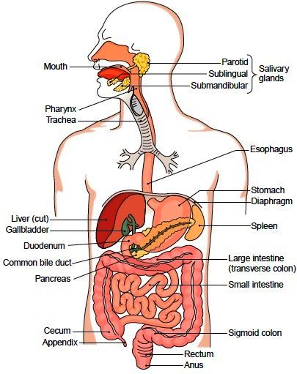
Let’s look at the gastrointestinal tract

Slide 8
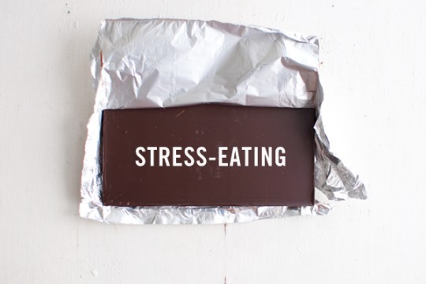
What does stress do to appetite?
Why do people tend to eat more when stressed?

Slide 9
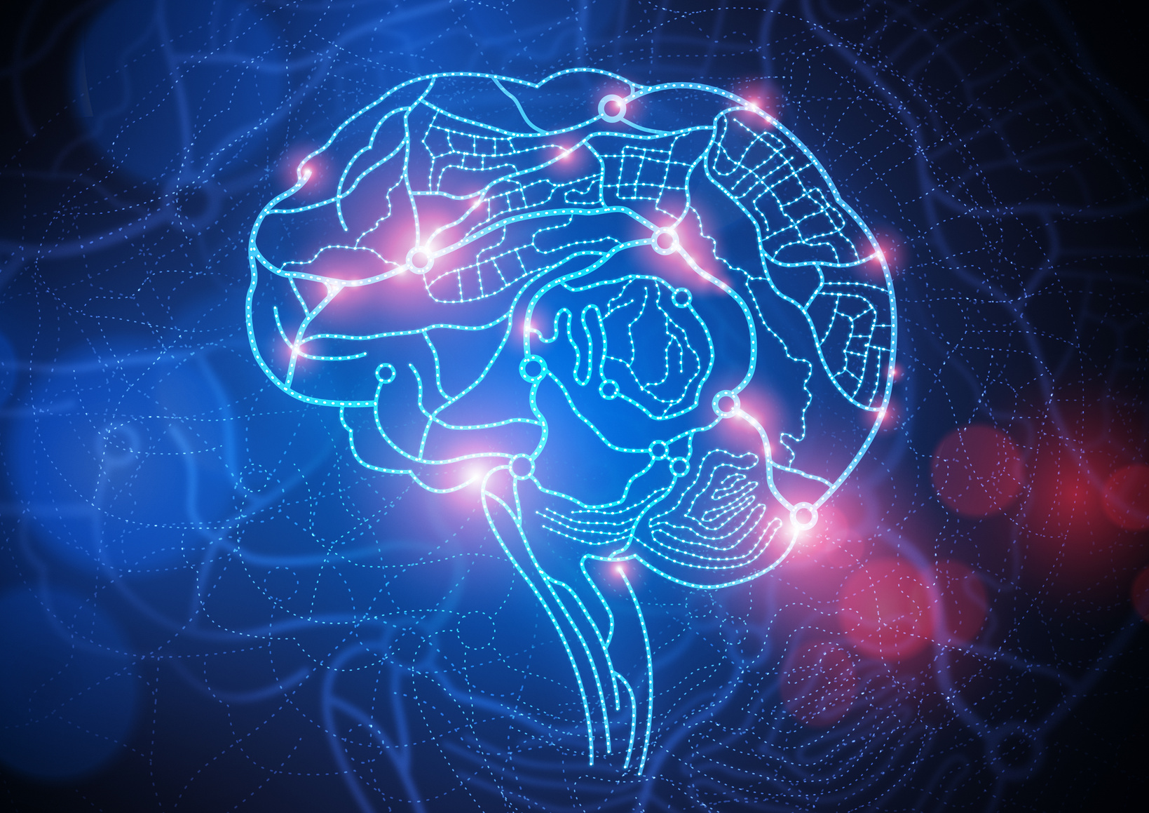
How does the brain influence eating when under stress?
Hypothalamic hormone
Pituitary stimulates adrenals
Glucocorticoids stimulate appetite

Slide 10
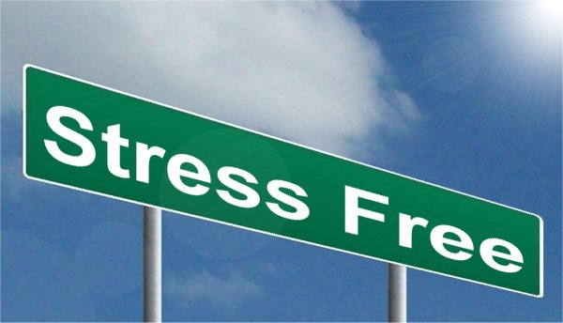
Stress ends!!!
Glucocorticoids go back to normal levels
Period of increased appetite

Slide 11
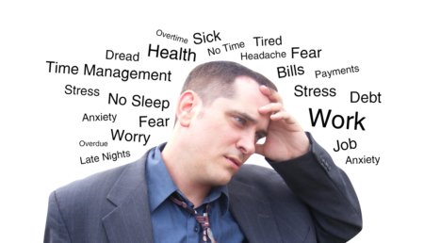
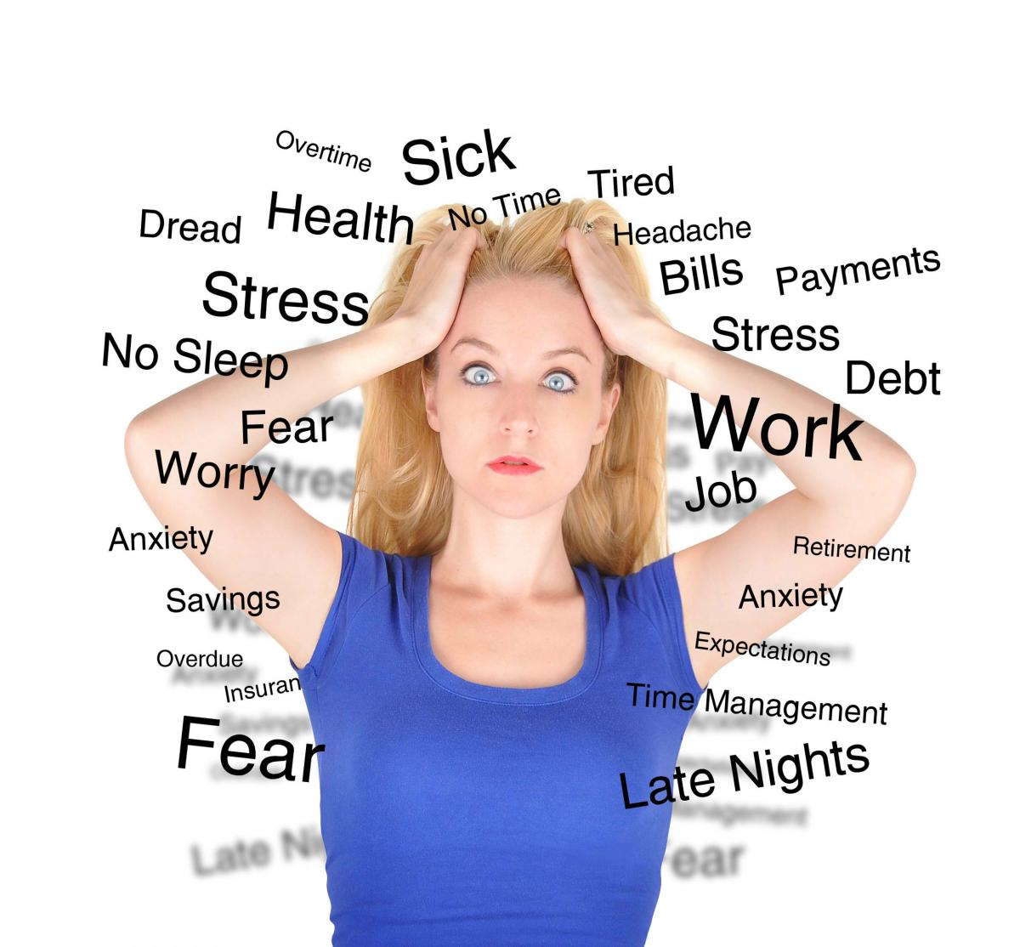
Now let’s look at chronic stress.
Bursts of intermittent stressors
Appetite increases
  Crave CHO
Excess nutrients

Slide 12
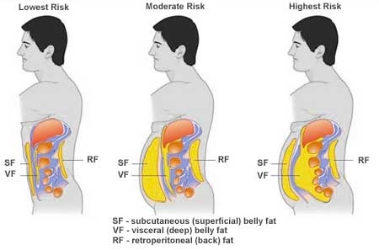
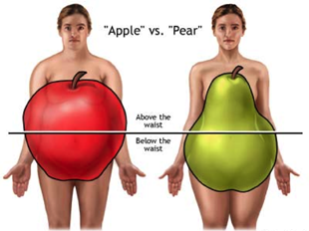
Two types of fat
Abdominal fat
Gluteal fat

Slide 13
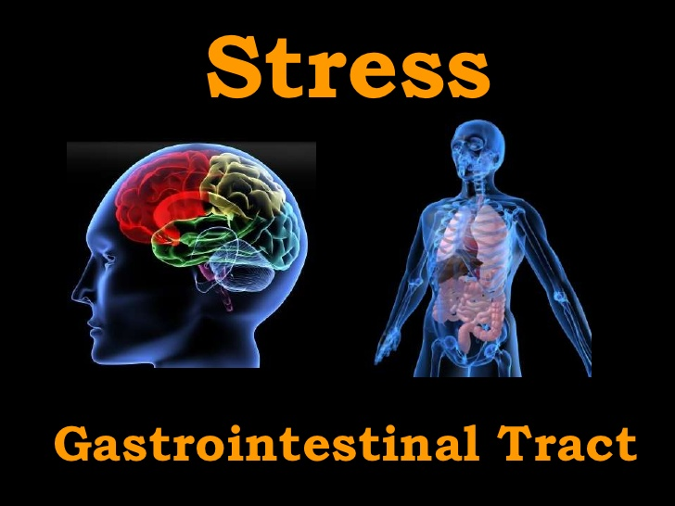
What happens to your GI tract under chronic stress?
Digestion shuts off
Disease risk increases

Slide 14
Two flavors of GI disorders
Organic bowel disorder
Functional bowel disorder
Has explanation
  Structure abnormality
  Lactase not performing
Diagnosis when there is no clue
Exquisitely sensitive to stress
IBS and spastic colon
Emotions via the ANS and stress hormones regulate your bowels

Slide 15
Organic and psychogenic bases of disease
Organic
Psychogenic
Focus on one piece, you miss the overall picture!
Understanding both is critical and informative!

Slide 16
Questions
What does stress have to do with craving carbohydrates?
Despite the discovery of a flashy bacteria that causes ulcers, why does stress help explain why only some people infected with the bacteria develop an ulcer?

